Slide 1

PRESENTATION : ONLINE SHOPPING SYSTEM
Team Roles
ARIF HASAN
0242220005341044
YEASIR ARAFAT
242310005341034
SAYEM ISLAM TAMIM
222-35-1186
Backend logic & database — debugged SQL query errors
Frontend UI & product pages — solved responsive design with CSS media queries
QA & testing — fixed login validation, cart issues, and database queries

Slide 2

Online Shopping System
A web-based platform designed to eliminate the inefficiencies of traditional shopping — enabling users to browse, compare, and order products from anywhere, anytime.
WEB APPLICATION
PHP · MYSQL · JAVASCRIPT

Slide 3


The Problem & Our Solution
Traditional Shopping Fails Because:
Requires physical presence and manual billing
No real-time product comparison or order tracking
Limited availability and inconvenient hours
Our platform lets users browse, cart, and order from any location — while admins manage everything from a central dashboard.

Slide 4

Project Objectives
Secure Auth
Session-based user authentication
Cart & Orders
Full cart and checkout functionality
MySQL Storage
Efficient data management
Admin Panel
Full control over products, users & orders

Slide 5
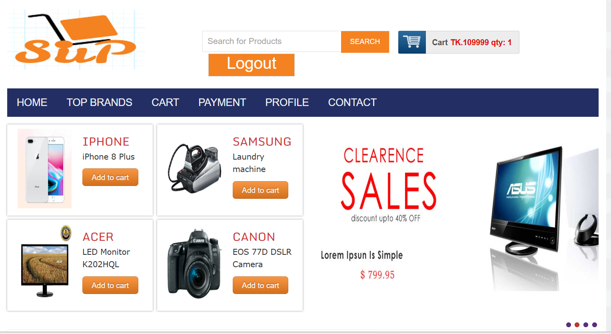
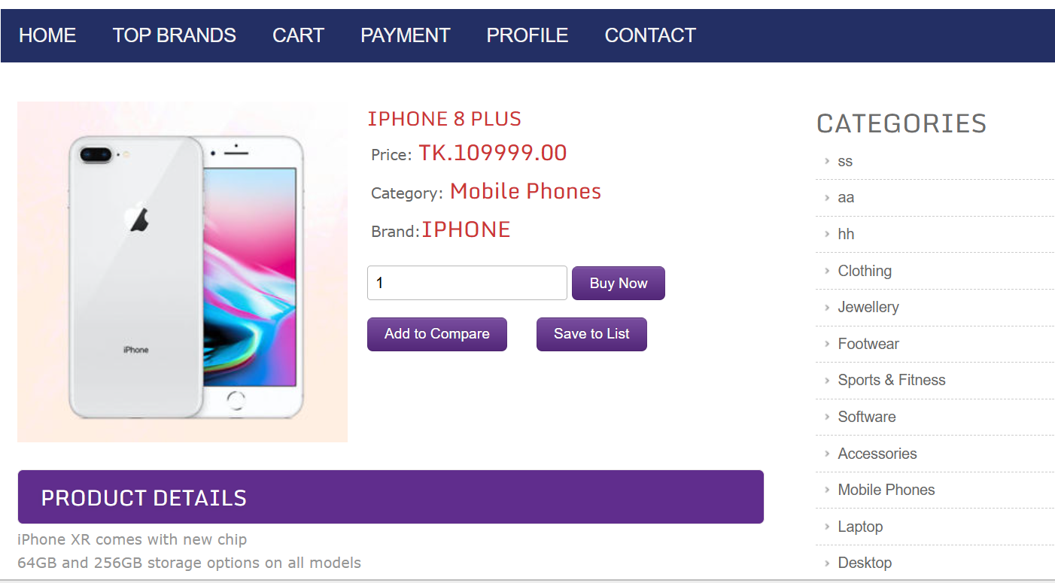
User Journey: Placing an Order
Open Homepage
Select Product
View full product details
Browse available products

Slide 6
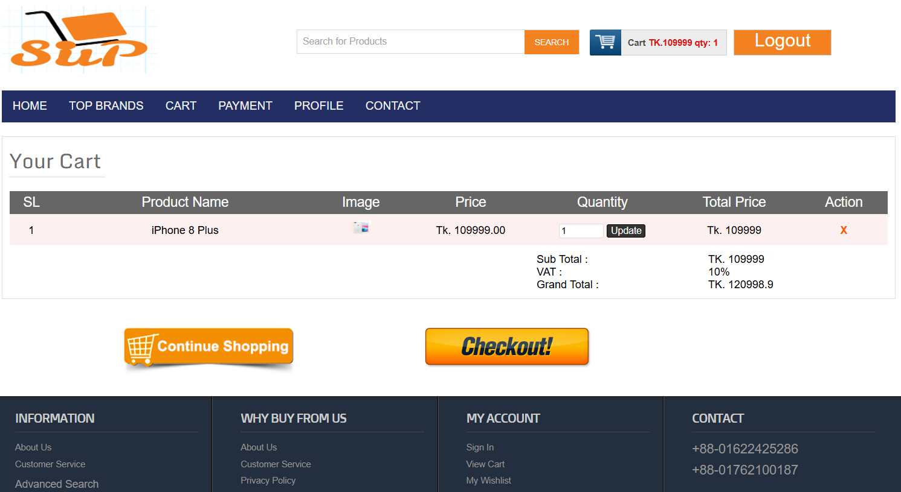
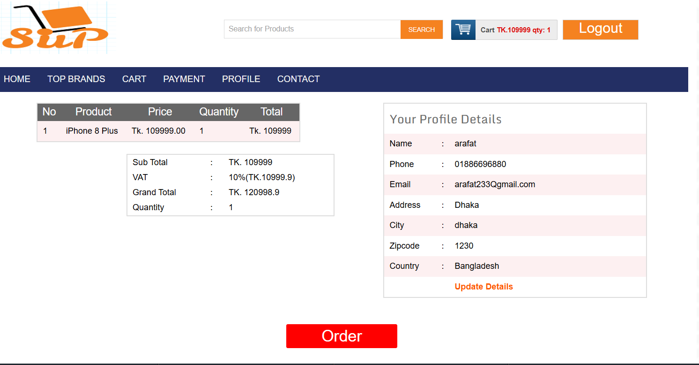
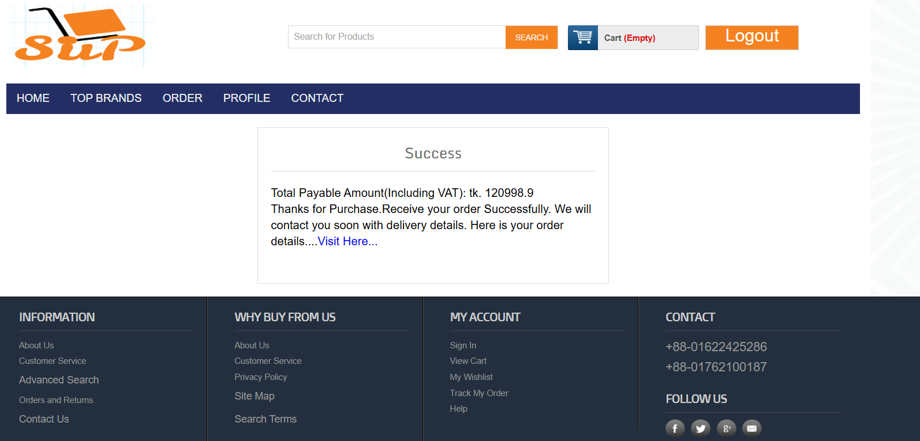
Add to Cart
Checkout
Review cart and confirm
Items stored in session
Order Confirmed
Saved to database

Slide 7
Functional Requirements
ID
Feature
Description
Status
FR-1
Registration
Create user account
✔ Done
FR-2
Login
Authenticate user via session
✔ Done
FR-3
Product Listing
Display all products
✔ Done
FR-5
Add to Cart
Store selected items in cart
✔ Done
FR-7
Checkout
Confirm and place order
✔ Done
FR-8
Order History
View past orders
⚠ Partial
FR-9
Admin Panel
Manage system data
✔ Done

Slide 8
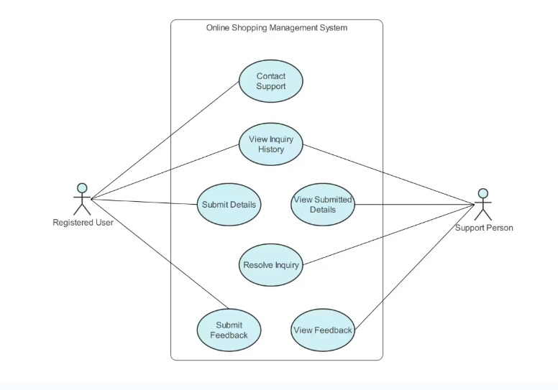
System Modeling
Use-Case Diagram:
The diagram represents a UML Use Case Diagram for an Online Shopping System, focusing on customer support activities. It includes two main actors: Registered User and Support Person.
The Registered User can perform actions such as Contact Support, Submit Details, View Inquiry History, and Submit Feedback. The Support Person is responsible for Viewing Submitted Details, Resolving Inquiries, and Viewing Feedback

Slide 9


Marketing Analysis
Target Audience: Online users, students, busy professionals
Channels: Social media, SEO, email marketing
Strategy: User-friendly design, fast access, comfortable

Slide 10
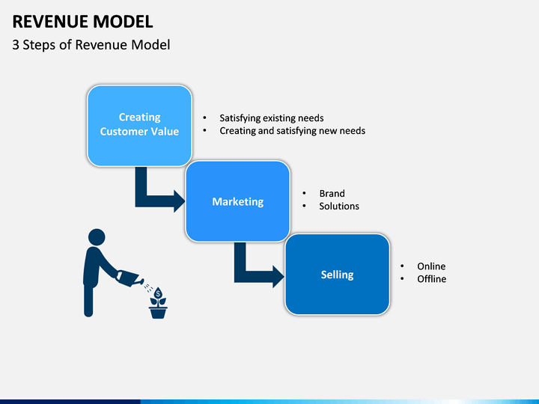
Revenue Model

Slide 11

Market Needs
Demand for convenience shopping
24/7 availability
Easy product comparison
Growing e-commerce trend

Slide 12

Conclusion & Future Work
The system successfully provides a fast, simple, and accessible online shopping experience.
💳 Online Payment
Integrate bKash & Nagad gateways
📱 Mobile App
Native mobile application version
🤖 AI Recommendations
Personalized product suggestions
📦 Order Tracking
Real-time delivery status updates
GitHub: github.com/arafat23617/Online-Shopping-System

Slide 13


